Slide 1
DATABASE MANAGEMENT SYSTEM MINI PROJECT- RESTAURANT RESERVATION
ANNAJASMINE I
KARTHEESWARI M
KIRUTHIKA B

Slide 2
PROBLEM STATEMENT:
DBMS problem statement from well-known restaurant chain in London, UK. To create a Database Management System for a table reservation process. Allow the customers to make a reservation for a specific Date & Time Provide ability for Add, Modify and Cancel their reservation. Maintain a record of past reservations Customer's Name ,Contact number ,Table number ,Reservation Data ,Time and the number of guests .To generate Reports for Daily, Weekly, Monthly and Yearly .The Database provide high performance to support the reservation process

Slide 3
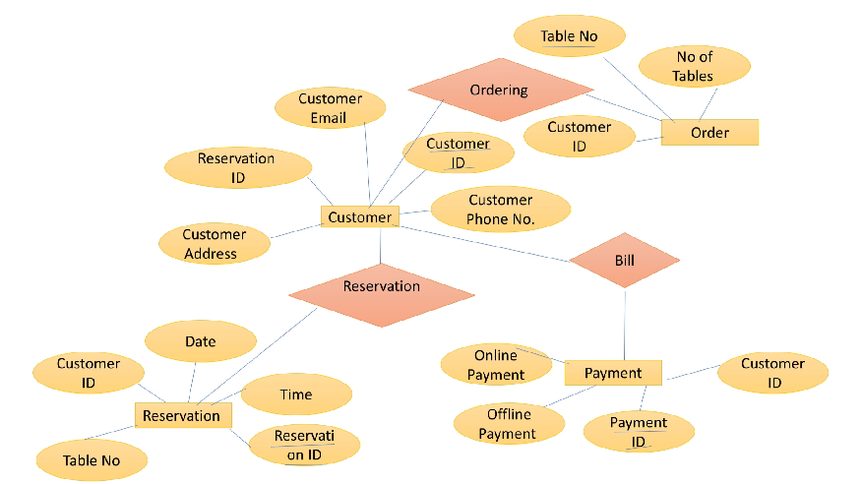
ER DIAGRAM

Slide 4
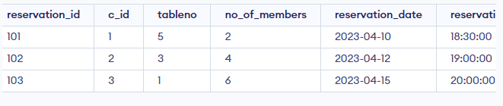
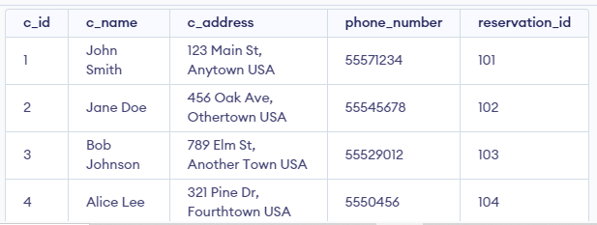
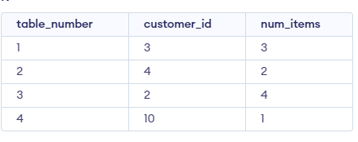
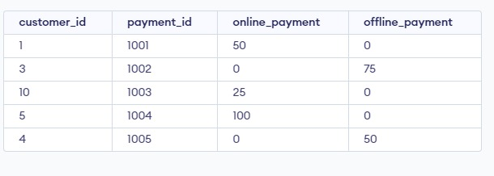
TABLE SCHEMA

Slide 5


FRONT END LANGUAGE
HTML
Hypertext MarkupLanguage
CSS
Cascading Style Sheets

Slide 6
FRONT-END DESIGN

Slide 7
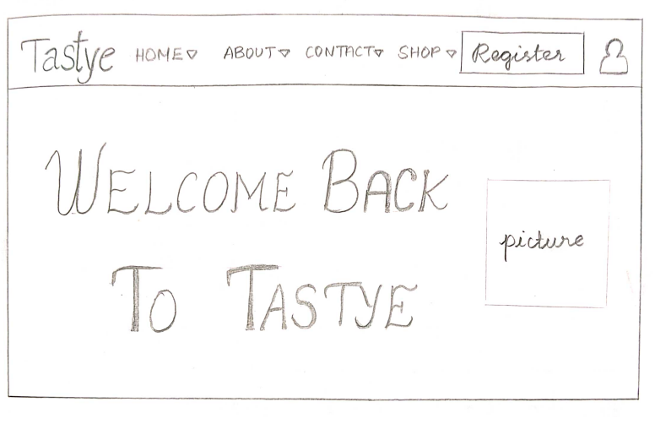

Slide 8
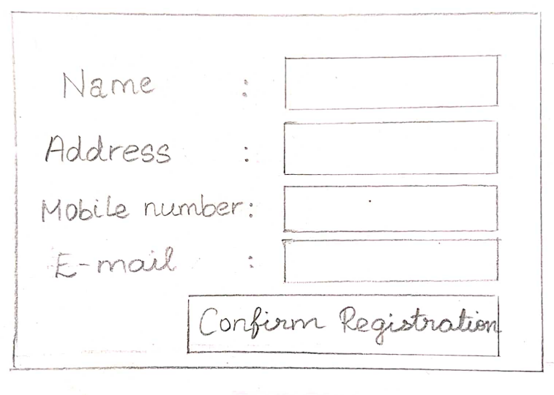

Slide 9
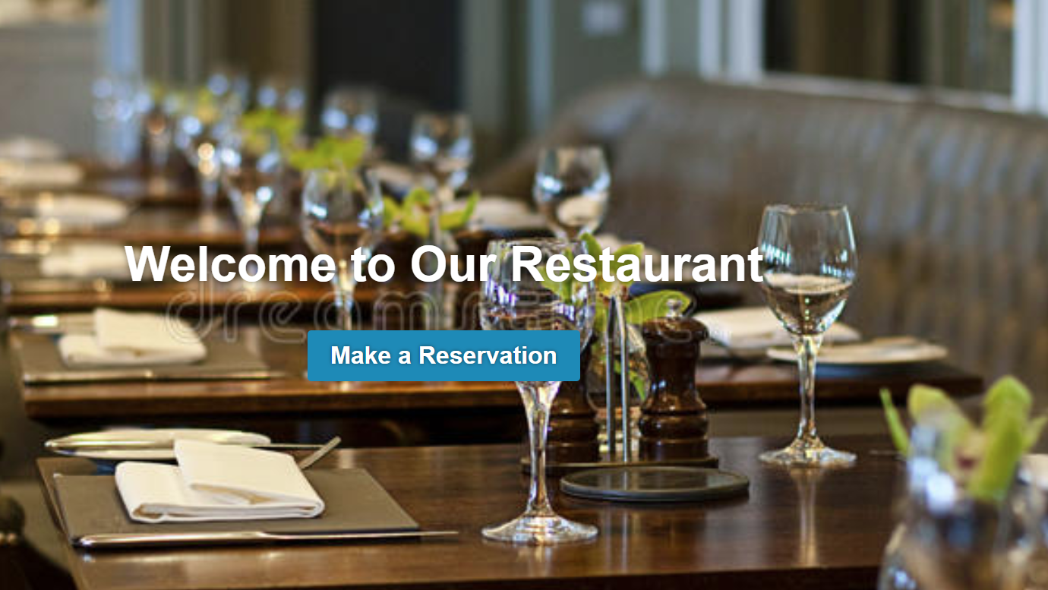
FRONT END DESIGN

Slide 10
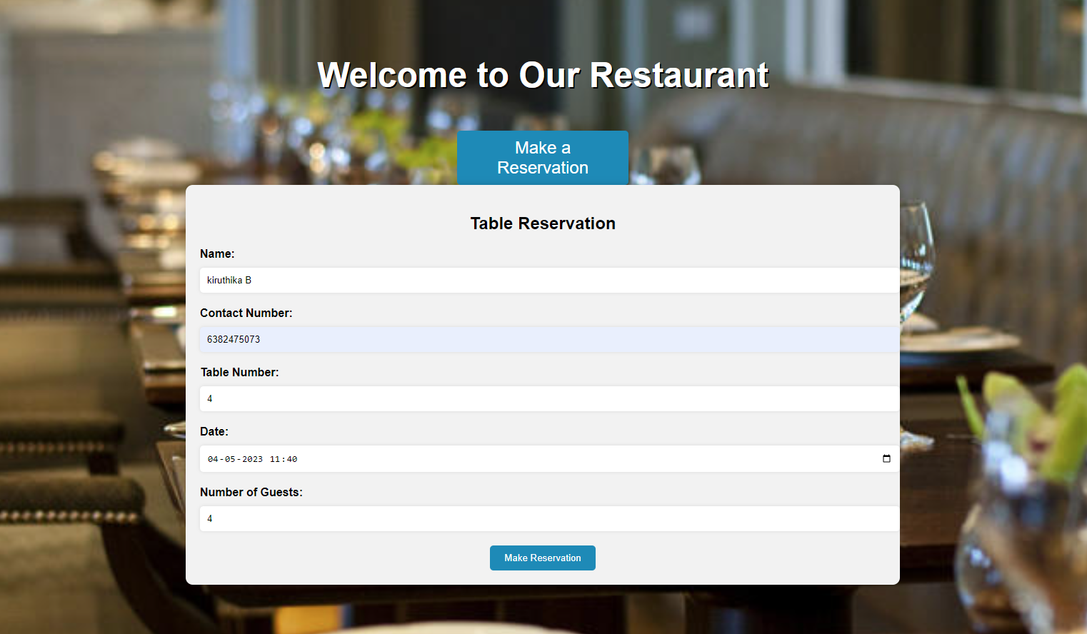

Slide 11
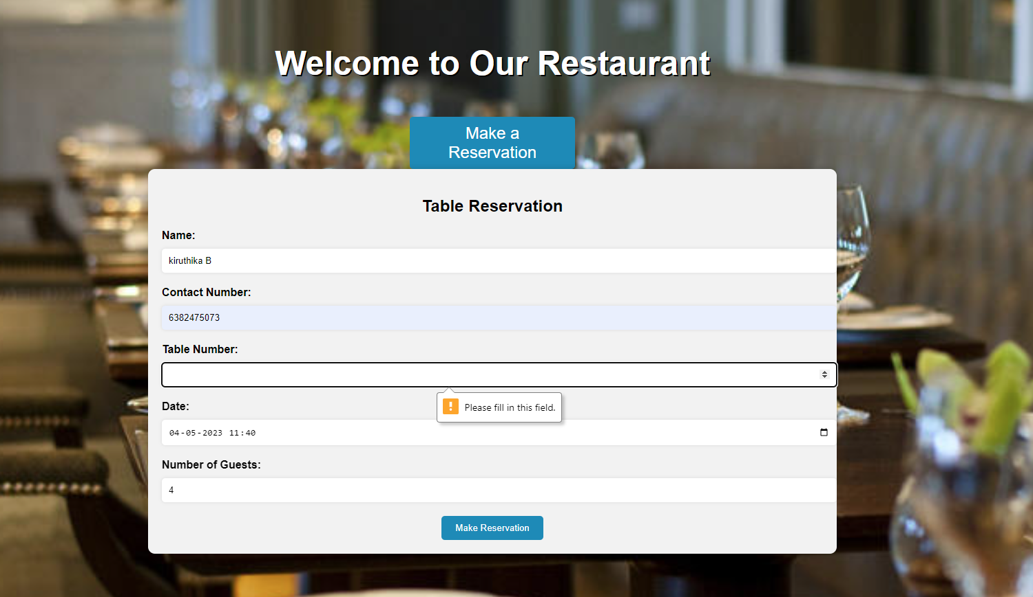

Slide 12
NORMALIZATION
Table 2: “Reservations"
reservation ID (primary key)
customer ID
Table 1: "Customers"
customer ID (primary key)
customer name
customer address
phone number

Slide 13
NORMALIZATION
Table 1: "Customers"
customer ID (primary key)
customer name
customer address
Table 2: "Customers2"
customer ID (primary key)
phone number

